Slide 1
Status Report: The Survivors
Corey Brown, Trevor Cantrell, Dennis Mesina, Gill Harjinder, Austin Lingenfelter • 11.07.2016

Slide 2
Overview
Expected Completion
December 1, 2016
Recent progress
Development of Isometric Map
GUI design confirmed
Movement of AI

Slide 3
Progress - GUI
Accomplishment 1
The Layout and design has been confirmed.
Script to manage GUI is in development.

Slide 4
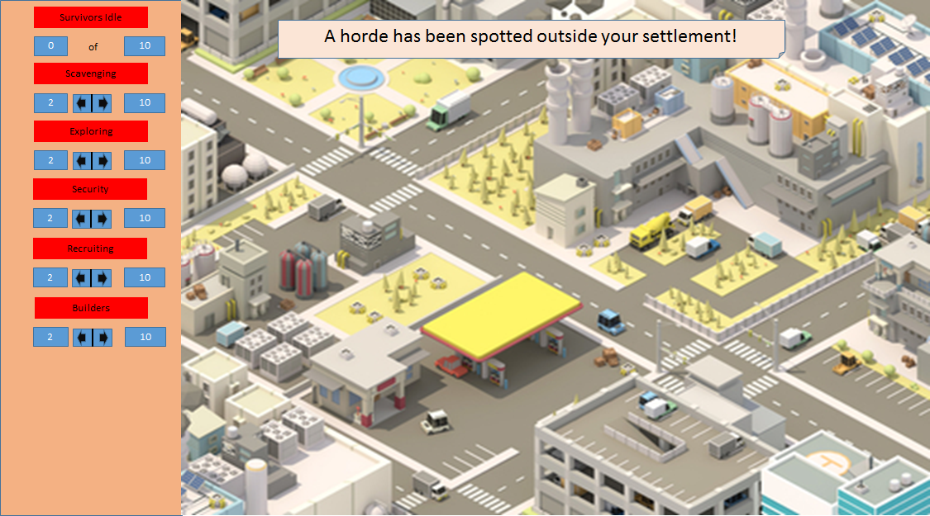

Slide 5
Progress - Isometric Map
Accomplishment 1
Grid has been applied to to the map.
This will allow for more simple building placement

Slide 6
Progress - AI
Accomplishment 1
The AI has been developed to react to the presence of nearby survivors.

Slide 7
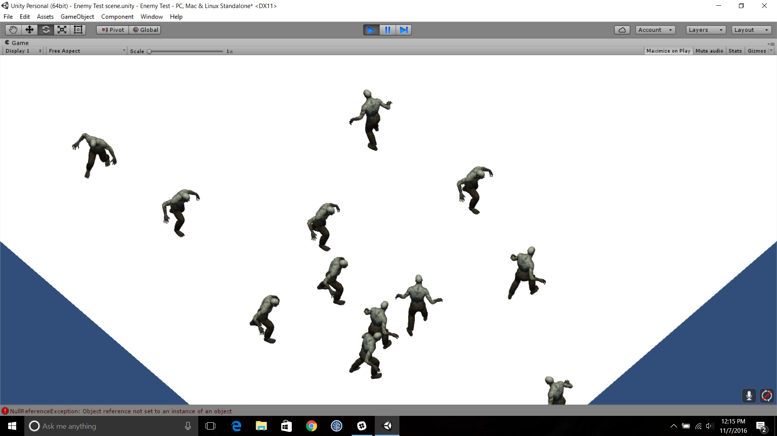

Slide 8
Schedule

Slide 9
Implement the GUI to the Game
Implement finalized Map design
Publication of final product.
11.15.16
11.20.16
11.22.16
11.28.16
12.01.16
Implement survivor movement routines
Add last minute touches to the “Zombies” and player interaction

Slide 10
Next steps
GUI
Implement in Unity with script.
Isometric Map
Add buildings and environmental features
AI
Work on the movement of the survivors.

Slide 11
Questions?

